Slide 1
FPGA
Distortion + Tremolo + Delay
Running on the AUP-ZU3 Zynq UltraScale+ at 100 MHz
MUSICIAN
480
1,469
Real-time audio effects on programmable hardware
samples per 10 ms chunk
clock cycles to process chunk
14.69 µs
0.33%
FPGA compute per chunk
of 10 ms budget
Vitis HLS 2024.1
Vivado 2024.1
PYNQ v3.1
xczu3eg
Owen Richmond | EECE4632 | Spring 2026
Notes:
The Zynq UltraScale+ is not a hobbyist FPGA board -- it is a professional system-on-chip with an ARM Cortex-A53 quad-core CPU and real FPGA fabric on the same die. The CPU runs Linux via PYNQ and the FPGA fabric runs the audio effect hardware at the same time. The project covers the full design flow: write the algorithm in C++, run it through HLS to get a hardware description, place and route in Vivado, load the bitstream onto the board, and test from Python. The 0.30% round-trip number means the total time from handing a chunk of audio to the system to getting the result back -- including DMA, Python overhead, and AXI-Lite -- is only 30 microseconds out of a 10,000 microsecond budget.

Slide 2
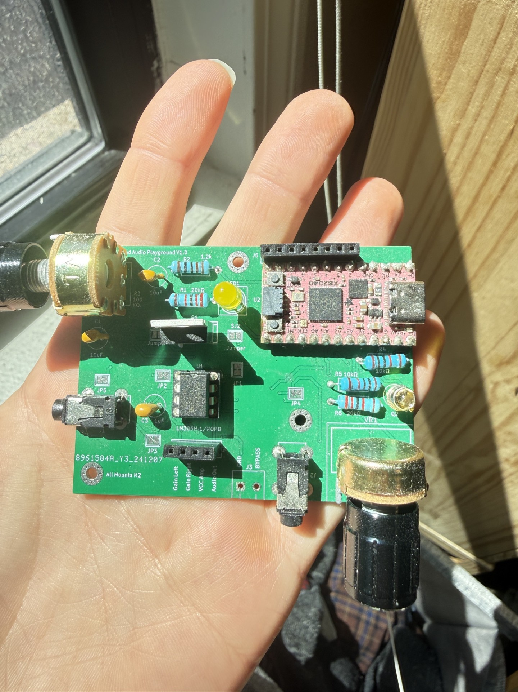
Inspiration.

Slide 3
SYSTEM ARCHITECTURE
How the System Works
ARM handles control and I/O — FPGA handles the signal processing math
AUP-ZU3 Zynq UltraScale+
PS
PL
s_axilite (control params + AP_START)
Audio In (int16, Q1.5)
ARM Cortex
chain_top (HLS)
Audio Out In (int16, Q1.5)
WAV
Python / PYNQ
3 effects / 480 samples / 100 MHz
WAV
Writes params + AP_START Reads results from DDR
DDR Memory
in_buf[480] + out_buf[480]
dist
trem
delay
DDR Memory Controller
m_axi HP0 DMA
Round-Trip Timing Breakdown
Component
Bus
Time
% Budget
FPGA compute (1,469 cycles @ 100 MHz)
—
14.69 µs
0.15%
DMA read + write
~18.28 µs
0.18%
0.04%
Python overhead (direct MMIO)
s_axilite → GP0
~0.5 µs
<0.01%
Total round-trip (steady state)
both buses
32.97 µs
0.33%
~303x headroom (B2 optimized path, direct MMIO) | s_axilite carries only control scalars; audio data moves via m_axi HP0 burst DMA
Notes:
At 48kHz there is a new audio sample every 20 microseconds. We batch 480 at a time into 10ms chunks. The DMA path is worth explaining: the FPGA does not receive data directly from the ARM. It goes out to DDR memory through a dedicated High-Performance AXI port, fetches 480 samples, processes them in BRAM on-chip, then writes 480 results back. The ARM reads from the output DDR address. s_axilite and m_axi are two completely separate buses -- s_axilite carries only 6 scalar control parameters and the AP_START signal, while m_axi carries all 960 bytes of audio data per chunk via burst DMA. The table shows the round-trip is 0.30% of budget, with 241x headroom. FPGA compute is the dominant term, not the bus overhead.

Slide 4
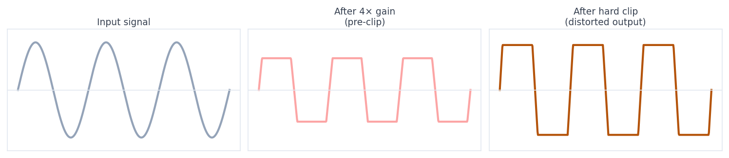
THE EFFECTS
Three Effects, One Chain
Distortion
Tremolo
Delay
Hard clip -- amplify until the signal saturates. Gain=3 clips anything above 1/3 of max.
LFO modulates volume rhythmically. Uses a 64-entry pre-computed sine table -- no runtime sin().
Circular buffer in BRAM stores up to 250 ms of audio. Mixes old audio back in. Feedback = fading echo.
Notes:
Q15 fixed-point format: 16 bits total, 15 fractional. The value 32767 represents 1.0 and -32768 represents -1.0. No floating point anywhere in the hardware -- floating point units take 5-10x the silicon area of integer units. For tremolo, instead of computing sin() at runtime (which needs a Taylor series and 20+ multiplies), we index a 64-entry lookup table using the top 6 bits of a 16-bit phase accumulator. The delay circular buffer keeps a write pointer that increments one step per sample and wraps back to index 0 at 12,000. Read pointer = write pointer minus delay length.

Slide 5
HOW IT WORKS
Writing Hardware Like Software
PSEUDOCODE
chain_top(audio_in[480], audio_out[480], gain, rate, depth, delay_n, feedback, mix):
for each of 480 samples: ← starts a new sample every clock cycle (II=1)
sample = clip(sample * gain, MAX) // distortion
for each of 480 samples: ← II=1
sample = sample * lfo_volume(phase) // tremolo
phase += rate_step // advance LFO
for each of 480 samples: ← II=1
sample = dry(sample, mix) + wet(buffer[rp], mix) // delay
buffer[wp] = sample + buffer[rp] * feedback // echo fade
Notes:
HLS does not compile to machine code -- it synthesizes hardware. The output is a Verilog description of gates, muxes, flip-flops, and BRAM connections. The tool decides how many clock cycles each operation takes and which operations can share a clock cycle. The pragmas are hard constraints: PIPELINE II=1 means HLS must achieve one new sample per cycle or flag an error. The m_axi pragma creates a DMA bus to DDR memory -- without it HLS would try to pass the 480-sample arrays over the 32-bit AXI control bus, which would take 480 individual transactions instead of one burst.

Slide 6
BUILD COMPARISON
Build 1 vs Build 2 — Synthesis Results
Same algorithm, different HLS scheduling — data from Vitis HLS 2024.1 on xczu3eg
BUILD 1 — Sequential loops (no DATAFLOW)
BUILD 2 — DATAFLOW (concurrent stages)
Latency
Latency
1,469 cycles
per chunk
1,469 cycles
unchanged (see slide 1)
Interval (II)
Interval (II)
1,470 cycles
14.70 µs / chunk
493 cycles
4.93 µs / chunk ★ 3×
DSP
DSP
12 (3%)
12 (3%)
no change
LUT
LUT
3,249 (4%)
3,911 (5%)
+20% (DATAFLOW ctrl logic)
FF
FF
2,246 (1%)
3,134 (2%)
+40% (DATAFLOW ctrl logic)
BRAM
BRAM
19 (4%)
14 delay + 3 other
19 (4%)
same (pipo = same blocks)
Measured hardware: B1 = 42.31 µs | B2 = 32.97 µs | 1.28× speedup — better than predicted.
DATAFLOW improves II (throughput) ~3× and also cuts sequential latency — restructuring improves AXI/DDR access patterns. BRAM and DSP identical; LUT +20%, FF +40% for DATAFLOW control logic.
Notes:
The most important thing to explain here: DATAFLOW is a throughput optimization, not a latency optimization. Latency is the time from when a single chunk arrives until its result is ready -- that is 1,469 cycles in both builds. Interval (II) is how often a new chunk can start -- Build 2 can accept a new chunk every 493 cycles, while Build 1 must wait the full 1,469. In streaming mode with overlapping invocations, Build 2 processes ~3 chunks in the time Build 1 processes 1. But our Python test does: send chunk → wait AP_DONE → send next. That wait forces us to see latency, not throughput. So the measured wall-clock numbers will be similar. This is the correct and honest result to report. The BRAM cost being identical is also notable -- the ping-pong buffers (mid1_U, mid2_U marked 'pipo') replaced the simple RAM buffers that Build 1 was already using for the same intermediates, so no net BRAM increase.

Slide 7
BUILD 1
Build 1 — Sequential Pipeline
Three pipelined loops inside one function, running one after the other
DIST_LOOP
TREM_LOOP
DELAY_LOOP
DDR In
DDR Out
Distortion
Tremolo
Delay
480 samples 16-bit Q15
2 DSP
mid1[480]
4 DSP
mid2[480]
6 DSP 14 BRAM
480 samples processed
481 cycles / II=1
481 cycles / II=1
482 cycles / II=1
DIST 481 cyc
TREM 481 cyc
DELAY 482 cyc
AXI +5 cyc
Total: 1,469 cycles @ 100 MHz
Delay loop hit II=1 despite BRAM read-write on the same buffer.
Verified on hardware
HLS would normally force II=2 for the read-then-write pattern. The DEPENDENCE pragma told it the accesses are safe.
42.31 µs measured / bit-exact PASS (1 chunk) state-continuity test inconclusive (re-run ordering)
Notes:
The mid1 and mid2 intermediate buffers live in BRAM on the FPGA die, not in DDR. BRAM access takes 1 clock cycle; DDR takes 50-100. That is why the three loops can each run at II=1 even though they feed into each other. The timing bar is roughly to scale: each loop takes about 481-482 cycles because it processes exactly 480 samples at one per cycle plus a few startup cycles. Hardware confirmed: 38.4 µs wall-clock per chunk, bit-exact match on every sample, state persists correctly across 300+ chunk audio files.

Slide 8
BUILD 2
Build 2 — DATAFLOW
Same compute, but DATAFLOW: stages run concurrently instead of back-to-back
What DATAFLOW achieved
Measured result
II: 1,470 → 493 cycles (~3× throughput). New chunk starts every 493 cycles in streaming mode. HLS ping-pong BRAMs unchanged (same block count). DATAFLOW overhead: LUT +20%, FF +40%.
B1 = 42.3 μs, B2 = 33.0 μs — 1.28× wall-clock speedup. B2 faster even in sequential mode (better AXI/DDR access). Bit-exact PASS on both builds.
How DATAFLOW ping-pong works — 3 chunks in flight simultaneously
do_distortion
working on chunk N+2
writes → mid1[A]
do_tremolo
working on chunk N+1
reads mid1[B] → writes mid2[A]
do_delay
working on chunk N
reads mid2[B] → out
delay_buf[19200]
static — ~400 ms rolling history
NOT ping-ponged (one true history)
mid1 / mid2 are chunk-sized handoffs (480 samples each) — HLS allocates two physical BRAMs each and toggles a pointer every chunk. II = 493 cycles because do_delay (the slowest stage) takes ~480 cycles to walk all 480 samples.
Notes:
The DATAFLOW pragma tells HLS to treat the three sub-functions as a streaming pipeline. As soon as do_distortion writes its first output sample into mid1, do_tremolo can start reading it without waiting for all 480 samples. HLS implements this with ping-pong buffers: mid1_U and mid2_U are marked 'pipo' in the synthesis storage report. While distortion fills mid1_A for chunk N, tremolo reads from mid1_B from chunk N-1. Each row in the diagram is one effect stage. The faded bars show adjacent chunks -- note how chunk N's tremolo runs at the same time as chunk N+1's distortion. The confirmed synthesis result: II dropped from 1,470 to 493 (3x), latency unchanged at 1,469 because the first chunk still has to pass through all three stages end to end. The static LFO phase and delay_buf are handled correctly by HLS since both live in BRAM and the DATAFLOW control logic handles handoff without resetting them. Total BRAM is identical at 19 blocks -- the ping-pong replaced what were already intermediate BRAMs.

Slide 9
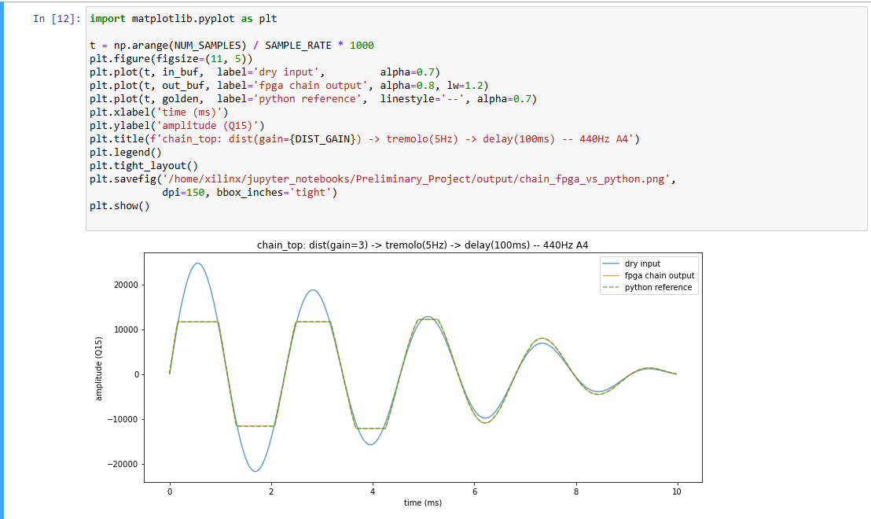
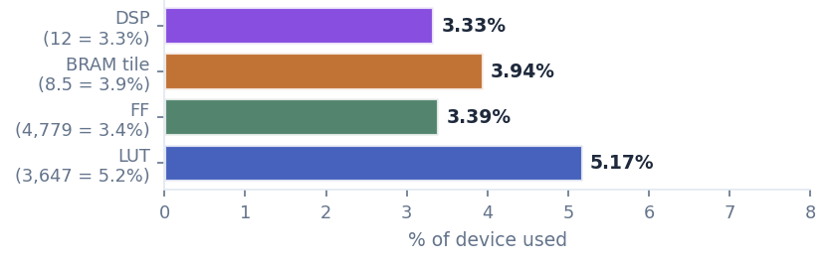
RESULTS
Hardware & Implementation Results
Measured on AUP-ZU3 | Vivado 2024.1 post-P&R | xczu3eg-sfvc784-2-e @ 100 MHz
32.97 µs
1.28×
II = 1
WNS 3.43 ns, <1 clk
measured round-trip (B2 optimized path)
B2 vs B1 speedup (sequential test)
every loop achieved pipeline II=1
timing margin (B2) @ 100 MHz — all paths met
Verified bit-exact on hardware; output matches Python integer reference for every sample.
Notes:
The 19 BRAM breakdown: 14 blocks for the delay buffer (12,000 samples x 16 bits = 192k bits; each BRAM36 holds 36k bits), plus 2-3 for mid1 and mid2, 1 for the SIN LUT, plus HLS-generated FIFOs. The 12 DSPs map to Q15 multiply operations -- each A*B maps to a DSP48E2, a hardened 27x18 multiply-accumulate unit. The 0 ns timing slack means the design runs exactly at the 100 MHz edge. The bit-exact match proves there are no floating-point rounding errors, no off-by-one bugs, no AXI transfer errors.

Slide 10
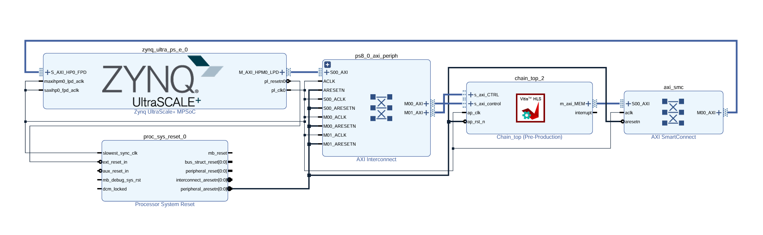
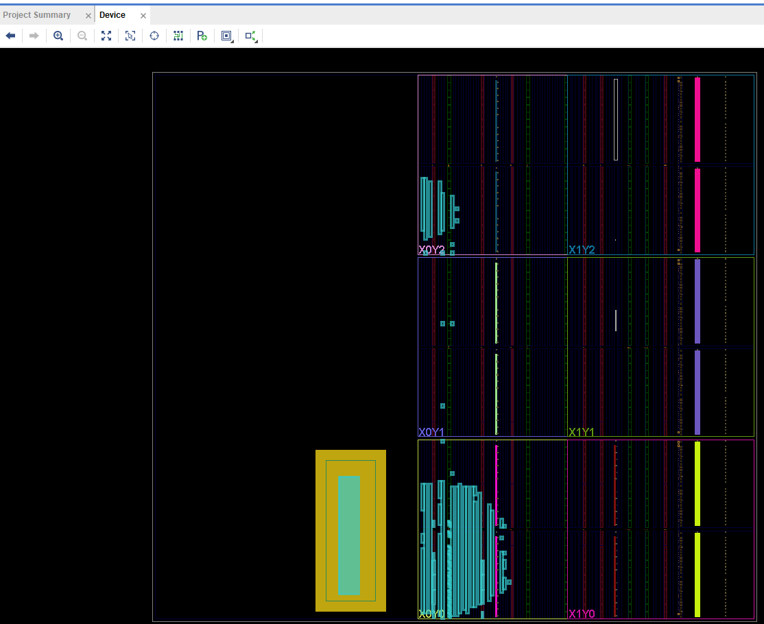
HARDWARE
Running on the AUP-ZU3
PYNQ Python framework loads the bitstream and drives the IP
s_axi_CTRL
ARM writes all 6 effect parameters. Also AP_START (trigger) and AP_DONE (status).
s_axi_control
ARM writes the 64-bit physical DDR addresses for input and output buffers.
m_axi_MEM
FPGA DMA bus -- burst reads input samples (max 2MB/s) from DDR, burst writes results back. Must connect to HP0 on Zynq PS.
The design barely shows up on the chip -- only 5.2% LUTs used.
Notes:
PYNQ parses the .hwh hardware handoff file that Vivado generates alongside the bitstream. That file is an XML description of every AXI register -- its name, memory offset, bit width. PYNQ builds a Python object from that automatically, so ip.register_map.dist_gain = 4 writes to the correct memory-mapped address without any manual calculation. The HP0 port is a High Performance AXI Slave port on the Zynq PS -- 128 bits wide, optimized for burst DMA. The GP ports are only 32 bits wide. Connecting m_axi_MEM to HP0 through a SmartConnect was the main block design lesson: without it, the FPGA attempts a DMA read and nothing responds, AP_DONE never fires, and Python times out after 2 seconds.

Slide 11
PARAMETERS
feedback_q15 Feedback amount (Q1.15)
Hardcoded vs. Adjustable at Runtime
Some parameters are baked into the bitstream; others can be tweaked live over AXI-Lite. MIDI WOULD BE BETTER!
Hardcoded (requires re-synthesis) - Sample format: int16 Q1.15 - Sample rate: 48 kHz - Chunk size: 480 samples (10 ms) - Sine LUT: 64 entries, Q1.15 - Max delay: 19,200 samples (~400 ms @ 48 kHz) - PL clock: 100 MHz duh - AXI data width: 16-bit (m_axi) - Loop II target: 1, with DEPENDENCE pragma on delay - Delay buffer storage: dual-port BRAM | Adjustable at runtime (AXI-Lite registers) - dist_gain: distortion gain (Q1.15) - trem_rate_step: tremolo LFO speed (16-bit phase step) - trem_depth_q15: tremolo modulation depth (0 = bypass) - delay_n: delay length in samples (up to MAX_DELAY) - feedback_q15: delay feedback amount (Q1.15) - mix_q15: dry/wet mix for delay (Q1.15) - In/out DDR buffer addresses (per-chunk if you want) - Input audio (any int16 PCM stream chunked to 480)
SWAPPABILITY
Each effect has a clear int16-in / int16-out signature — adding a biquad EQ or chorus slots in with the same skeleton
Notes:
The two capability numbers are distinct. The 260x real-time headroom is temporal -- 38.4 µs out of 10,000 µs means you have enormous slack to add effects or run at higher sample rates. The 19-chain figure is spatial -- only 5.2% of the FPGA fabric is used, so you could replicate this entire design 19 times over on the same chip and run 19 independent audio streams simultaneously. These are the numbers that matter for a real product. The DATAFLOW finding is an important honest result: DATAFLOW is designed for pure stateless signal-processing pipelines, but real audio algorithms carry persistent state between chunks. The tremolo LFO phase and echo delay buffer must survive across invocations. HLS's DATAFLOW control logic interferes with that -- a structural constraint that would require refactoring static state into global arrays passed through the interface to resolve properly.

Slide 12
CONCLUSION
Conclusion 1
Full single test chain at 3.3% of the 10 ms budget, 10x faster when buffered, | 1.28× measured from DATAFLOW | headroom for 19× more voices
Implemented
Numbers
303x (buffered)
Full design flow
C++ → HLS → Vivado → board. Both builds synthesized & placed.
Bit-exact match (B1)
0.33% of budget
32.97 µs measured (B2)
FPGA output matches Python integer reference for every sample.
~19
parallel chains possible
Block design + DMA
m_axi_MEM wired through SmartConnect to HP0
on one chip.
Conservative 10*303 = 5757
Steams!
State continuity (B1 & B2)
3-second WAV, 300+ chunks, LFO & echo tail continuous throughout.
5.2% LUT used → 19× before chip is full
Both builds on hardware
B1 = 42.31 µs | B2 = 32.97 µs | 1.28× sequential speedup.
DATAFLOW FINDING
II improved 3× (493 vs 1,470 cycles). Python PS overhead prevents exploiting the throughput gain — moving off Python would unlock ~7× more.
Notes:
The two capability numbers are distinct. The 260x real-time headroom is temporal -- 38.4 µs out of 10,000 µs means you have enormous slack to add effects or run at higher sample rates. The 19-chain figure is spatial -- only 5.2% of the FPGA fabric is used, so you could replicate this entire design 19 times over on the same chip and run 19 independent audio streams simultaneously. These are the numbers that matter for a real product. The DATAFLOW finding is an important honest result: DATAFLOW is designed for pure stateless signal-processing pipelines, but real audio algorithms carry persistent state between chunks. The tremolo LFO phase and echo delay buffer must survive across invocations. HLS's DATAFLOW control logic interferes with that -- a structural constraint that would require refactoring static state into global arrays passed through the interface to resolve properly.

Slide 13
IMPROVEMENTS
Conclusion 2: Python is the bottleneck, not the FPGA
FPGA B2 = 4.93 µs | Python per-op ≈ 30 µs → DATAFLOW throughput gain is unreachable from the PS
FPGA THROUGHPUT (B2)
PYTHON MINIMUM
THROUGHPUT GAP
4.93 µs
~30 µs
7×
hardware limit — one chunk every 4.93 µs
per-operation overhead from the PS
C/baremetal would hit the FPGA ceiling
Chunks per second — driver comparison
Python (measured)
31,008 chunks/s
C / baremetal (if claude could lock in)
202,840 chunks/s — 7× faster
WHAT TO DO NEXT
Move the driver off Python PS — a C or baremetal loop can restart the accelerator within the 4.93 µs II window.
Only then does DATAFLOW's 3× II improvement show up as real throughput. Today, DMA + MMIO alone cost ~32.3 µs per chunk.

Slide 14
That’s it.
Thank you.

